Slide 1
Topic 7.2.3: Types of IPv6 Addresses

Slide 2
IPv6 Address Types
There are three types of IPv6 addresses:
Unicast
Multicast
Anycast
Note: IPv6 does not have broadcast addresses.
Notes:
7.2.3.1 IPv6 Address Types

Slide 3
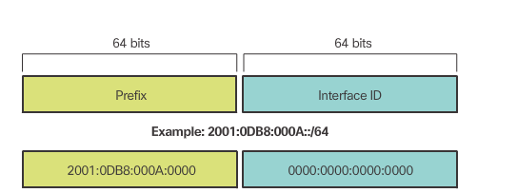
IPv6 Prefix Length
IPv6 does not use the dotted-decimal subnet mask notation.
Prefix length indicates the network portion of an IPv6 address using the following format:
IPv6 address /prefix length
Prefix length can range from 0 to 128
Typical prefix length is /64
Notes:
7.2.3.2 IPv6 Prefix Length

Slide 4
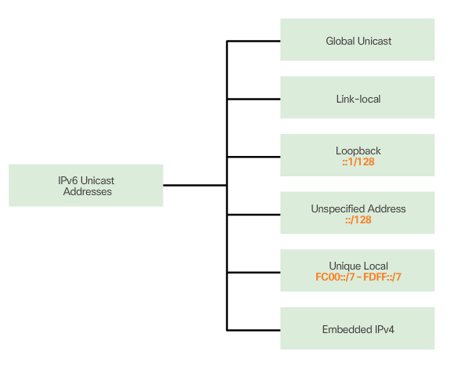
IPv6 Unicast Addresses
Notes:
7.2.3.3 IPv6 Unicast Addresses

Slide 5
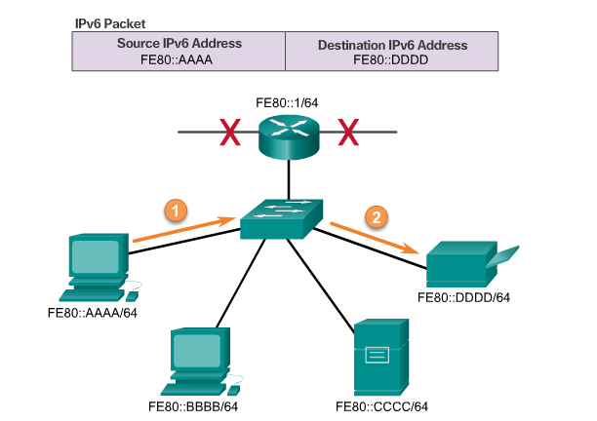
IPv6 Link-Local Unicast Addresses
Notes:
7.2.3.4 IPv6 Link-Local Unicast Addresses

Slide 6
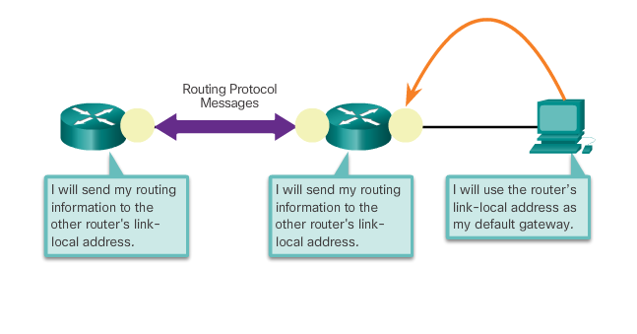
IPv6 Link-Local Unicast Addresses (cont.)
Uses of an IPv6 Link-local address
Notes:
7.2.3.4 IPv6 Link-Local Unicast Addresses (Cont.)
7.2.3.5 Activity – Identify Types of IPv6 Addresses

Slide 7
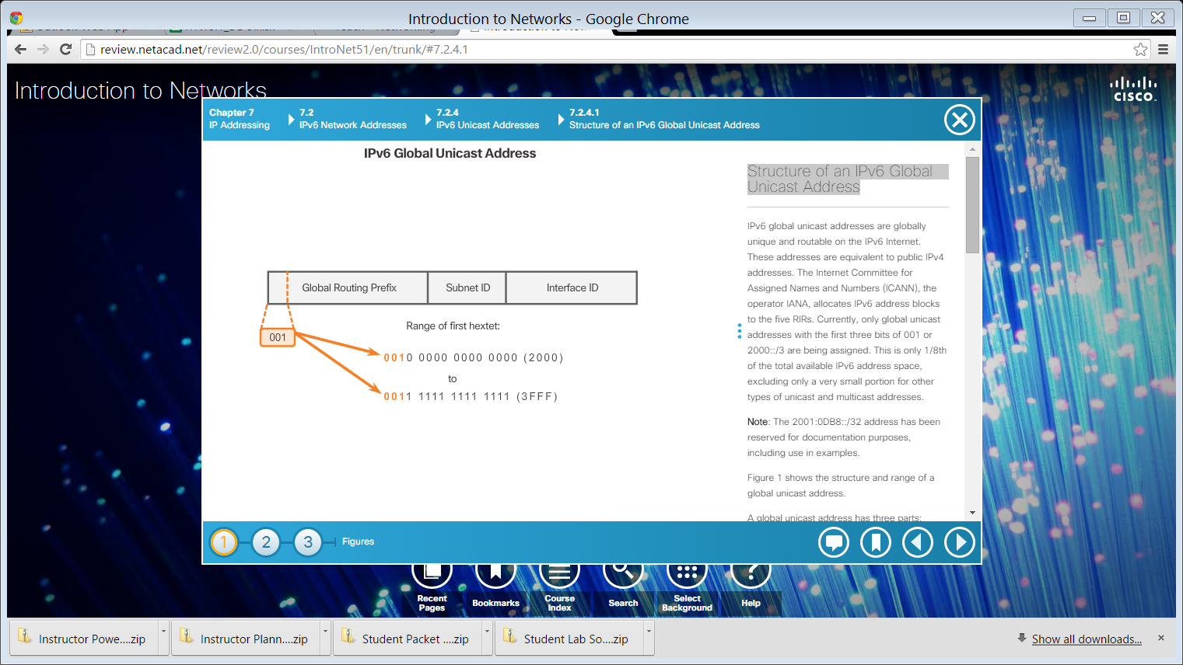
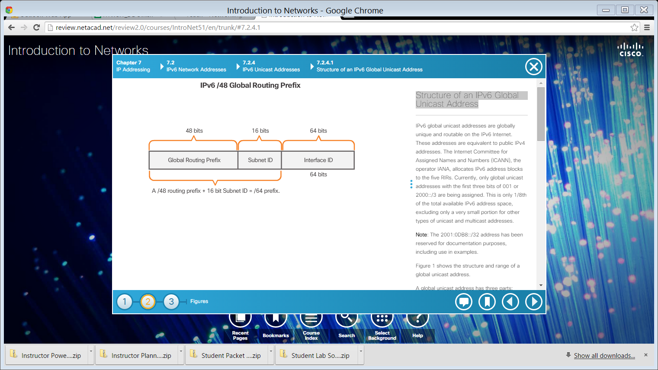
Structure of an IPv6 Global Unicast Address
Notes:
7.2.4.1 Structure of an IPv6 Global Unicast Address

Slide 8
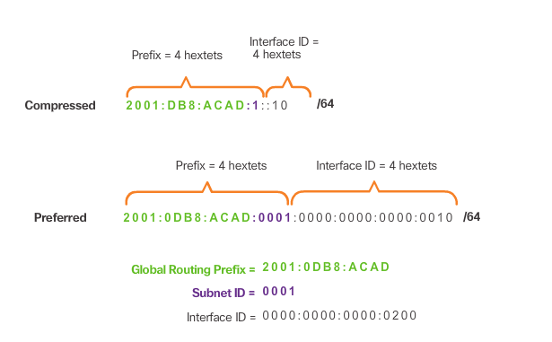
Structure of an IPv6 Global Unicast Address (cont.)
Reading a Global Unicast Address
Notes:
7.2.4.1 Structure of an IPv6 Global Unicast Address (Cont.)

Slide 9
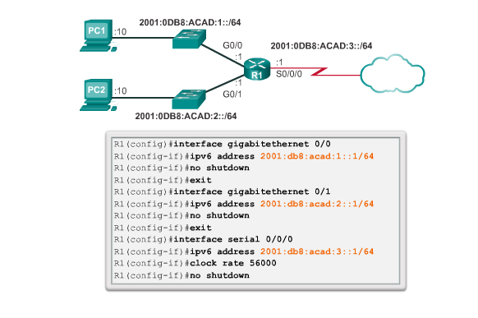
Static Configuration of a Global Unicast Address
Notes:
7.2.4.2 Static Configuration of a Global Unicast Address

Slide 10
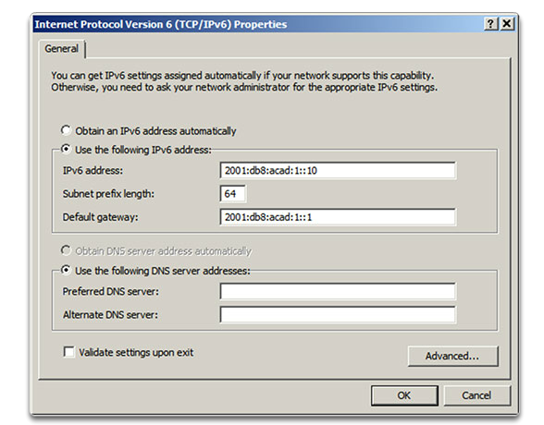
Static Configuration of a Global Unicast Address (cont.)
Notes:
7.2.4.2 Static Configuration of a Global Unicast Address (Cont.)
7.2.4.2 Syntax Checker - Configure the IPv6 global unicast address

Slide 11
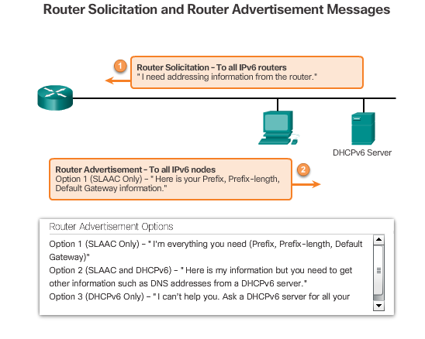
Dynamic Configuration - SLAAC
Notes:
7.2.4.3 Dynamic Configuration - SLAAC

Slide 12
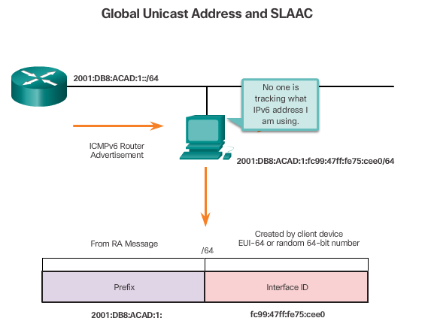
Dynamic Configuration – SLAAC (cont.)
Notes:
7.2.4.3 Dynamic Configuration – SLAAC (Cont.)

Slide 13
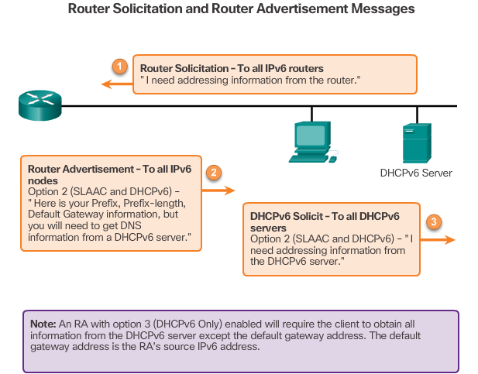
Dynamic Configuration – DHCPv6
Notes:
7.2.4.4 Dynamic Configuration – DHCPv6

